Slide 1
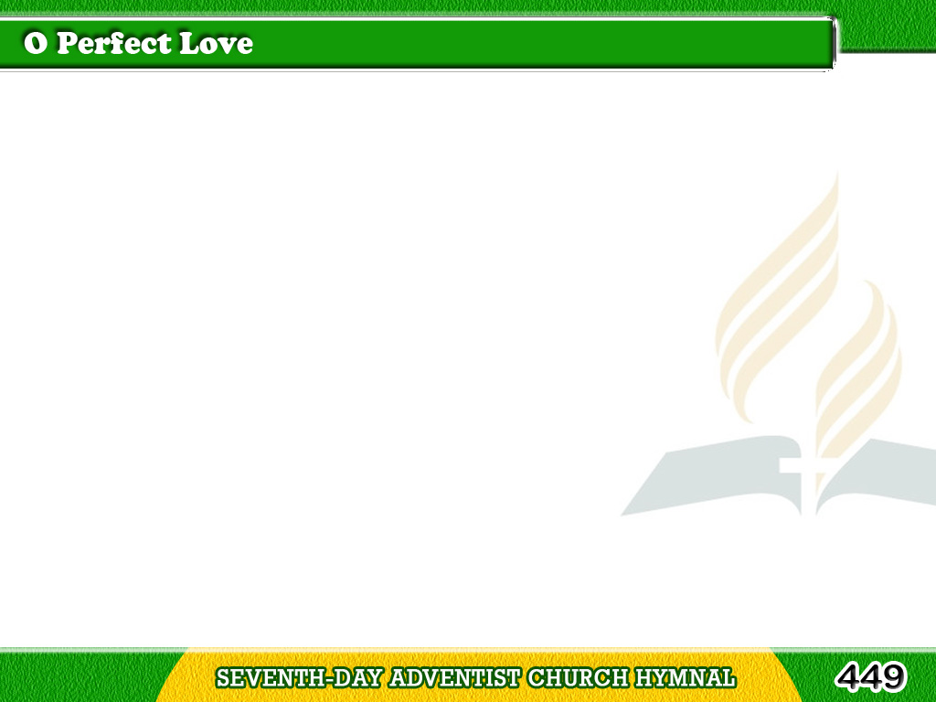
1/3
O perfect Love,
all human thought transcending,
Lowly we kneel in prayer
before Thy throne,
Tagalog
Version

Slide 2
1/3
That theirs may be
the love that has no ending,
Whom Thou forevermore
dost join in one.
Tagalog
Version

Slide 3
2/3
O perfect Life,
be Thou their full assurance,
Of tender charity
and steadfast faith,
Tagalog
Version

Slide 4
2/3
Of patient hope,
and quiet, brave endurance,
With childlike trust
that fears nor pain nor death.
Tagalog
Version

Slide 5
3/3
Grant them the joy
which brightens earthly sorrow;
Grant them the peace
which calms all earthly strife,
Tagalog
Version

Slide 6
3/3
Add to life’s day the glorious
unknown morrow
That dawns upon
eternal love and life.
Tagalog
Version

